Slide 1
CST2550 - 2025
Software Engineering and Management
Week 8: Analysis of Algorithms
Ahmed Eissa
a.eissa@mdx.ac.uk

Slide 2
Learning Objectives
Understand algorithmic complexity.
Analyse and optimise algorithms.
Implement efficient solutions.

Slide 3
1. Algorithm Analysis

Slide 4
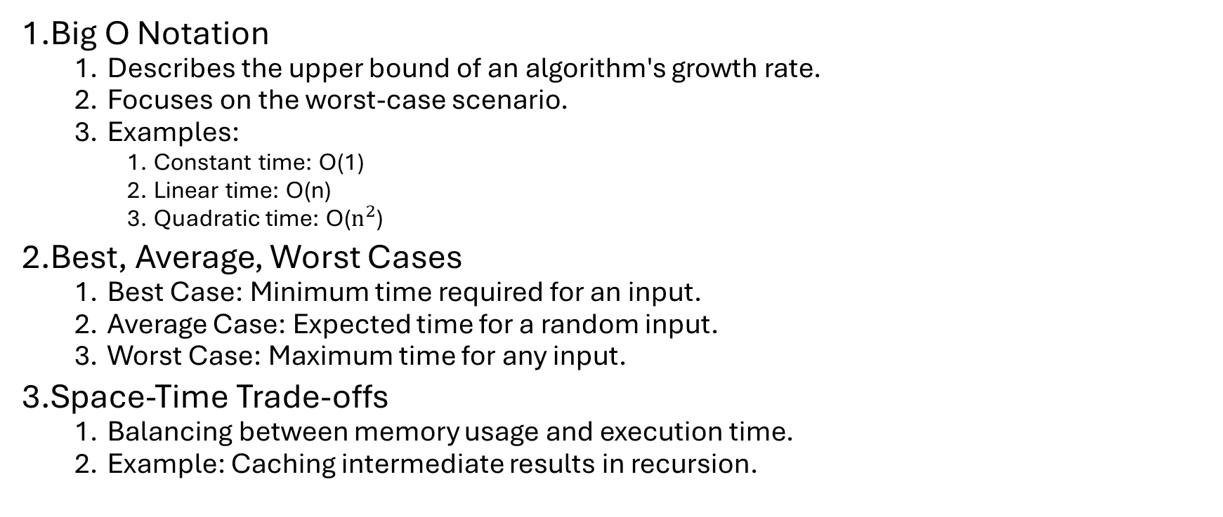
Time Complexity
Big O Notation
  Describes the upper bound of an algorithm's growth rate.
  Focuses on the worst-case scenario.
  Examples:
    Constant time: O(1)
    Linear time: O(n)
    Quadratic time: O($n^{2}$)
Best, Average, Worst Cases
  Best Case: Minimum time required for an input.
  Average Case: Expected time for a random input.
  Worst Case: Maximum time for any input.
Space-Time Trade-offs
  Balancing between memory usage and execution time.
  Example: Caching intermediate results in recursion.

Slide 5

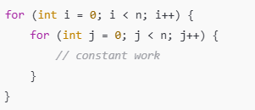
Mathematical Formula for
Time Complexity
Simple Loops:
Formula:
Nested Loops:
Formula:

Slide 6
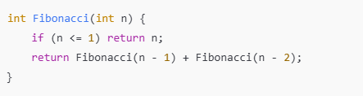
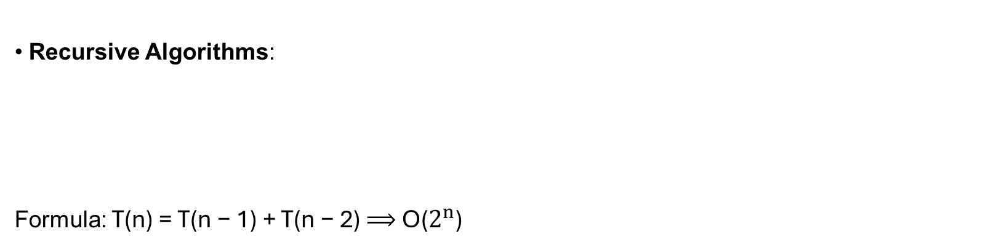
Mathematical Formula for
Time Complexity
Recursive Algorithms:
Formula: T(n) = T(n − 1) + T(n − 2) ⟹ O($2^{n}$)

Slide 7

Examples
For Loops: A single loop iterating n times has a time complexity of O(n).
Example:
Formula:
  T(n) = Work per iteration × Number of iterations
  = C ⋅ n ⟹ O(n)

Slide 8
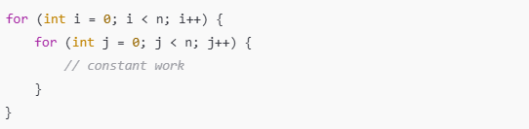

Examples
Nested Loops: If one loop is nested inside another, time complexity multiplies.
Example:
Formula:
  T(n) = n ⋅ n = $n^{2}$ ⟹ O($n^{2}$)

Slide 9
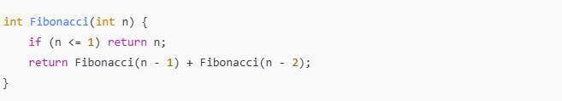
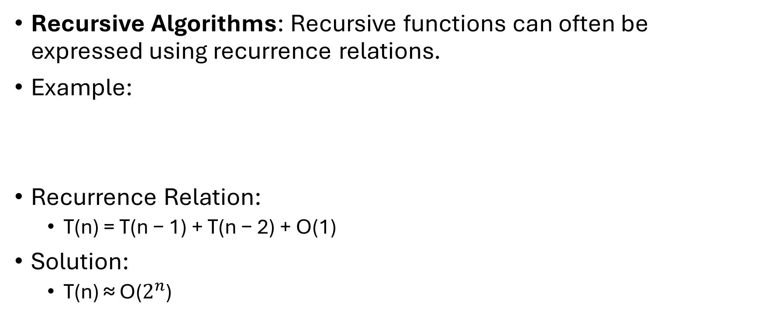
Examples
Recursive Algorithms: Recursive functions can often be expressed using recurrence relations.
Example:
Recurrence Relation:
  T(n) = T(n − 1) + T(n − 2) + O(1)
Solution:
  T(n) ≈ O($2^{n}$)

Slide 10
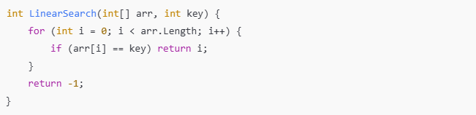
Practical Examples
Linear Search:
  Best Case: Key is found in the first position 𝑂(1)
  Worst Case: Key is not present 𝑂(𝑛)

Slide 11
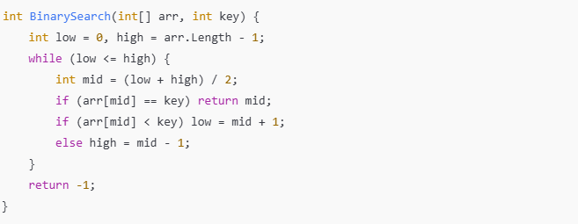
Practical Examples
Binary Search:
  Time Complexity: Reduces the search space by half each time: O(log⁡ n)

Slide 12
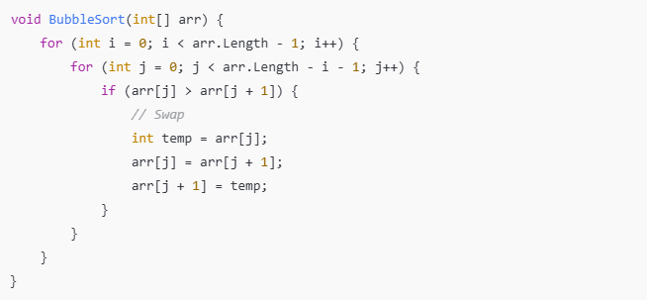

Practical Examples
Bubble Sort:
  Best Case: 𝑂(𝑛) (Already sorted with no swaps).
  Worst Case: 𝑂($n^{2}$) (Reverse sorted).

Slide 13
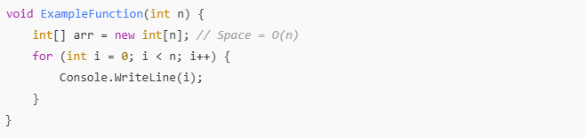
Space Complexity
Definition:
  Measures the memory required by an algorithm, including input size, temporary variables, and recursion stack.
  Example:
  Complexity: 𝑂(𝑛).

Slide 14
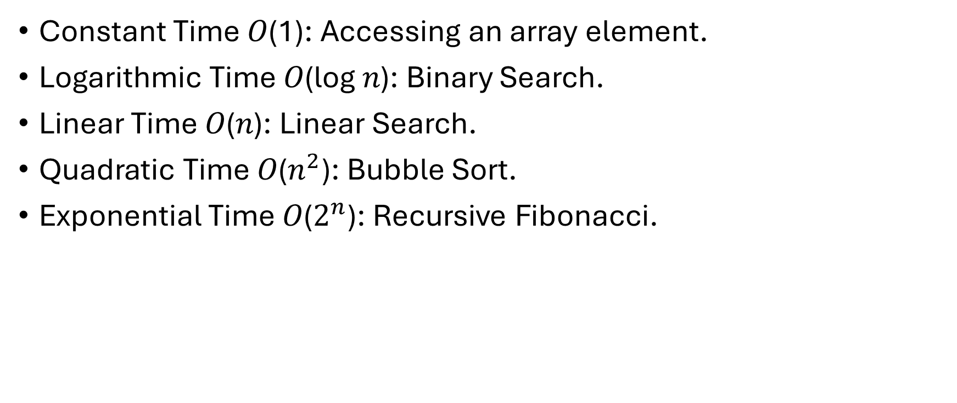
Common Complexity Classes
Constant Time 𝑂(1): Accessing an array element.
Logarithmic Time 𝑂(log ⁡𝑛): Binary Search.
Linear Time 𝑂(𝑛): Linear Search.
Quadratic Time 𝑂($n^{2}$): Bubble Sort.
Exponential Time 𝑂($2^{n}$): Recursive Fibonacci.

Slide 15
2. Practical Examples

Slide 16
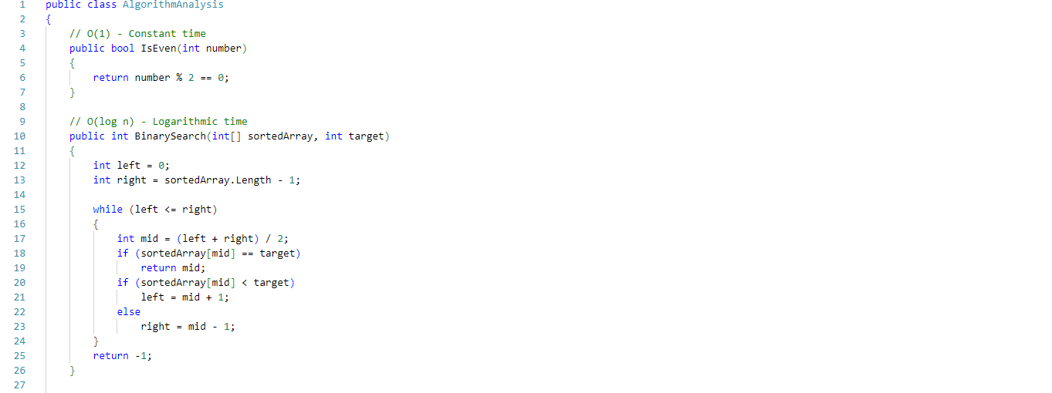
Example: Algorithm Analysis

Slide 17
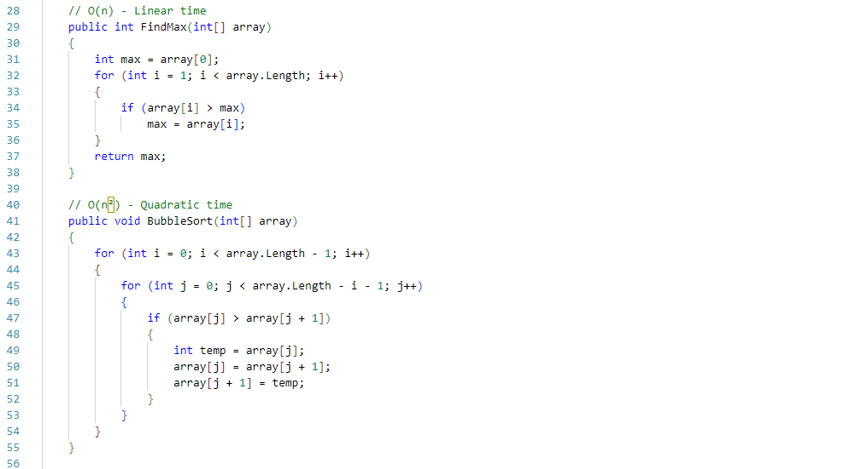
Example: Algorithm Analysis

Slide 18
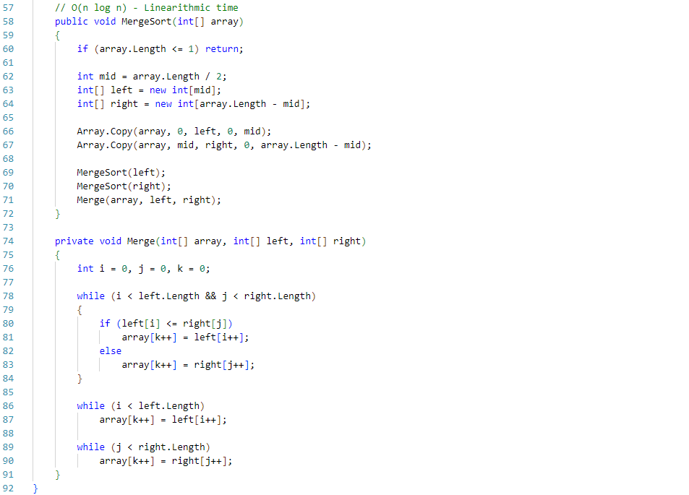
Example: Algorithm Analysis

Slide 19
Further Reading
Books:
  Introduction to Algorithms by Cormen, Leiserson, Rivest, and Stein.
  Algorithms by Robert Sedgewick and Kevin Wayne.
Online Resources:
  Big O Cheat Sheet
  GeeksforGeeks: Algorithm Analysis
Tools:
  Visual Studio Profiler.
  Online Complexity Calculators.

Slide 20
Next Week
Week 9: The Principles of Parallel Processing and Multi-Threading in C#

